Slide 1
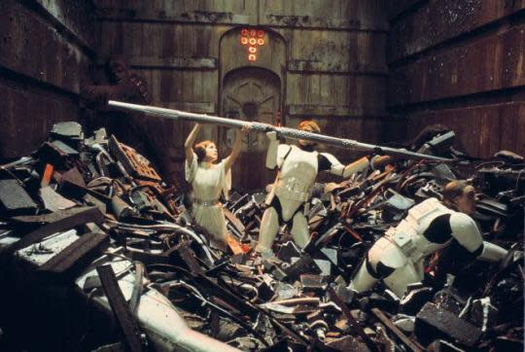
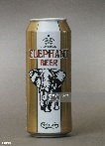
FBI
development
1983/4 SANTA CLAUSE(zhanty road)
2010
INTERNET PAYMENTS:
Darth Vader (gorbachev(aniken)
POLIZEI Gaggenau
Compactoin Garbage Dump, Gaggenau
“Where to I put these items?” Bmw, Moving Boxes
KOCHMANN
Apple.Christmas. Christmas truck commecial
White.trash
- Cleaning my room, sit in the toys ( Age 3-4+)
Tim and steve cocain
nonPoliceInitLogial
kit
41.KIT. University.nonPoliceRouteLogial
Go to Florian’s house
Go to Daniels Houe DEA(crack)
nonPolcieContentItem
White.trash

Slide 2

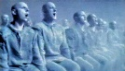

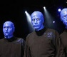


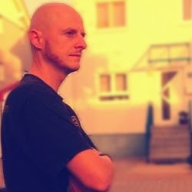
FBI
development
41.IPX
Sticker WAR
Against child poronogyr
Gegen kinderporno
Oprah, pbs, Sandra: Sticker
KOCHMANN Cola5
Jascon 5
Broken Window[]:
ATOMICBOBM(c5,j5).HEILDERBERG
Police Omaha(lovey,mika)
Thomas Genzer Brother Genzer
FBI:KIDNNPAING:Kidnapper
Gorbache(mika,PENTAGON:BASE:KINDGARDNER)

Slide 3

FBI
development
Earnings.nonPolcieMonitoring
Invert.CHART
Chart
Interupts

Slide 4
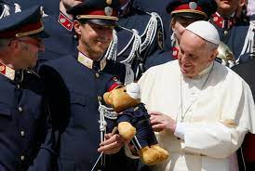
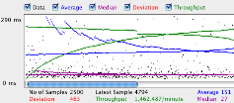
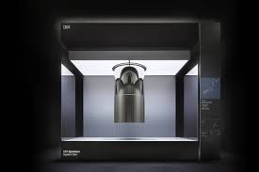
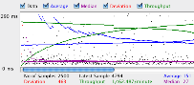
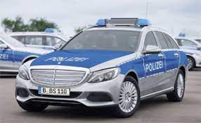
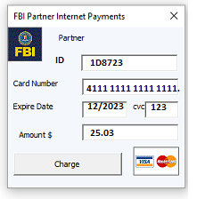
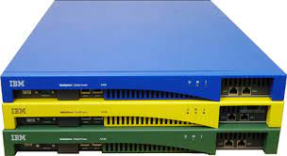
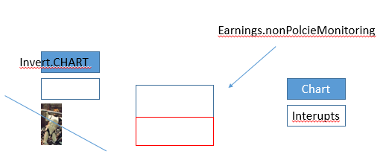


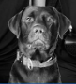
FBI
development
FBI:WHITE COLAR
L1 Cache
QUANTUM ASSEMBLY
f(x)=3+i6
Complex Number and Real Number
ATB 1/0 Binary ASSMEBLY
MATRIX QUANTUM MATRIX
1|0|0|1 2+i4
0|1|1|0 3+i7
MARKETING
POLICE nonPoliceXML PROCESSOR
Ibm datapower xml processor
Charting the course to 100,001 qubits
CHART
CHARTS
CPU
Processing
Unit
J2EE
2s
PERFORMANCE
L3 Cache
L2 Cache
1.s
C++
Qubits
0.1s
Assembly
ASSEMBLY
SALES
Performance
XS40 SOA XML Network
Security Gateway 9235
IBM Websphere Datapower XS40 SOA XML Network Security Gateway 9235-
KING.Pet Cematary
Korset Stephanie
HOMICDIE:DOG
v2.FBI:KIDNAPPING no child; dog(
[x]no
FBI:WHITE COLAR
JFK(2005 marly, bob lee; labrador)
2006 IBM Parnter Dogs (vacation dogwalkers)
poodle
Odi
Other: HOMICDIE:CAT

Slide 5
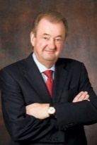
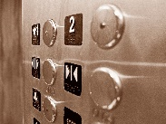
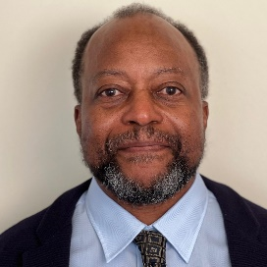

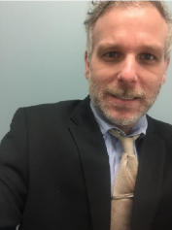
FBI
development
FBI:WHITE COLAR
nonPolicePerformance
APPLICATION
MARKETING
https://ics2wsa.ic3.com/commerce/1.x/transactionProcessor/CyberSourceTransaction_1.207.wsdl
Performance
CHART
CHARTS
PERFORMANCE
SALES
WSDL
Web Archive
Other:
AVAIABILITY
LUKE(lukanvick, mihceal)
Visa HOMICIDE:DOG.sigature
!LUKE(KING,ghohe(micehal)
2005 VIRGINA
FBI:HOOVER bob/bob/marley
!WHITE
MLK
Report from Black
does nothing
JFK
Repro to White
Does nothing
Touch.accentuer.damiler.ibm.roth
MLK.IPX(Otis(Morgan)
FBI:WMD for Financial Markets
ATOMICBOMB(Timer)
Timo,ghoe(micha)
dog
Morgan(tanl) mornign
Odi
https://www.linkedin.com/in/otismorgan?original_referer=https%3A%2F%2Fwww.google.com%2F

Slide 6
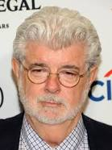
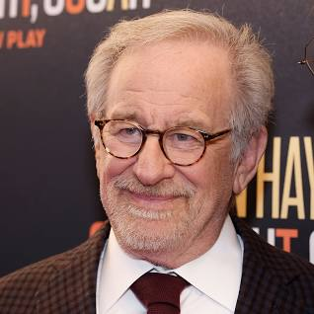
FBI
development
A Proclamation on Granting Pardon for the Offense of Simple Possession of Marijuana
21 U.S.C. 844 and as previously codified elsewhere in the United States Code, or in violation of D.C. Code 48–904.01(d)(1),
IPX

Slide 7
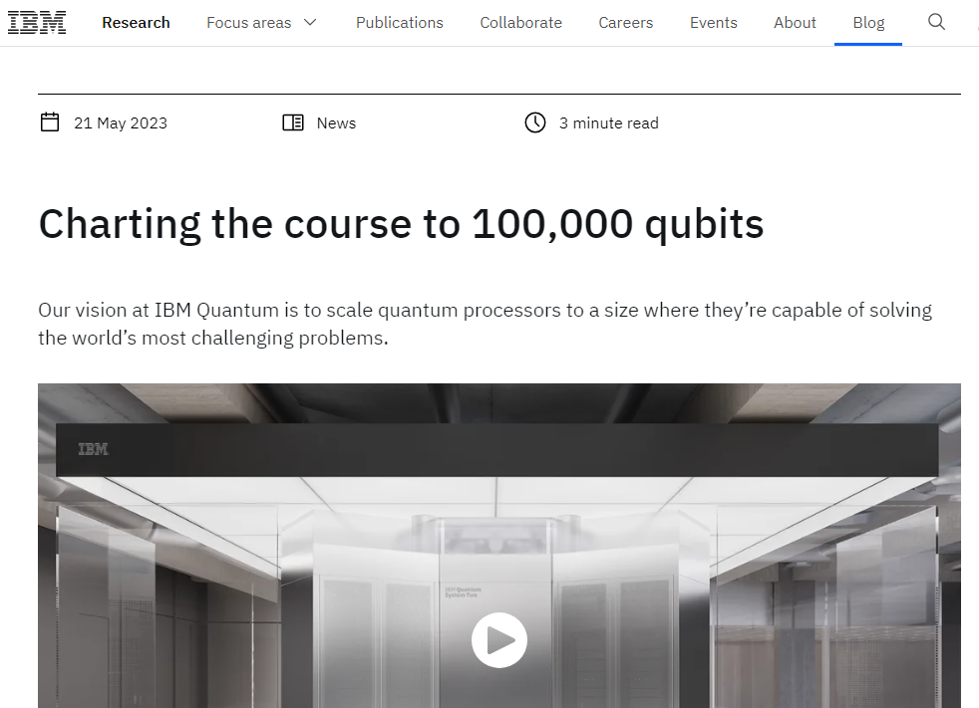
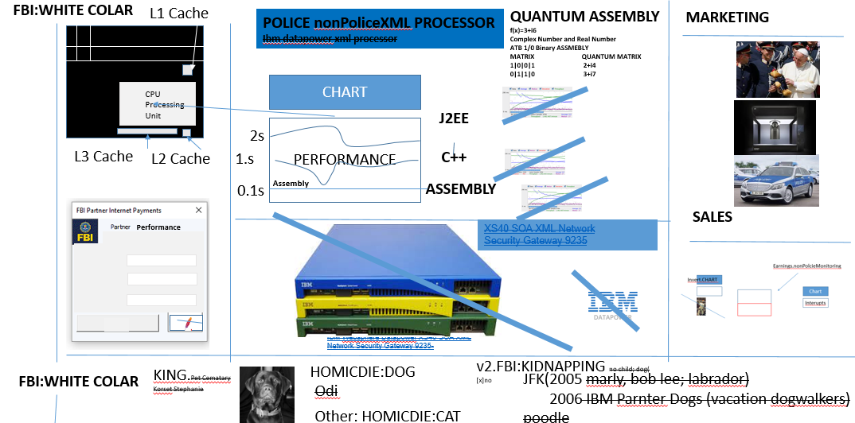
FBI
development
CPVA
MARKETING
deere
Guy breathing at court
Joespe Sextoin, William McKern, etc
Wating for products?
JOSPEPH
COMPETION
CHECKPOINT CHARLIE(Brain, Kernel, IBM Cash Register)
Insets alexander stahl
2006/8
Alexivi/aliexv.Davidson.touch.accenteyr.apple.daimer.ibm.roth
20014/15
Ivan/ivan.Davidson.touch.accenteyr.apple.daimer.ibm.roth
FACEBOOK
§187.PREA

Slide 8
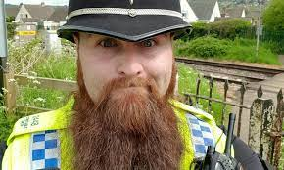
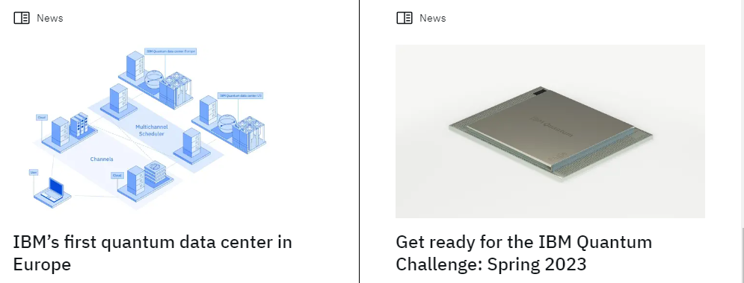
FBI
development
FBI:WHITE COLAR
L1 Cache
MARKETING
APPLICATION
Charting the course to 100,001 qubits
O
ur (Enterprise Architecture; Certified) vision at nonPolice Quantum is to scale quantum processors to a size where they’re identifying malpractice in business process manamgent and providng best pratices.
MARKETING
CPU
Processing
Unit
The 100,001 Qubit Quantum-Centric Supercomputer of 2033
L3 Cache
In order to get there, we’ve set our sights on a key milestone: a 100,000-qubit system by 2033. And now, we’re sponsoring and partnering on targeted research with the University of Tokyo and the University of Chicago to develop a system that would be capable of addressing some of the world’s most pressing problems that even the most advanced supercomputers of today may never be able to solve.
But why 100,000? At last year’s IBM Quantum Summit, we demonstrated that we’d charted the paths forward to scaling quantum processors to thousands of qubits — but beyond that, the path is less clear.
Why? It’s a combination of footprint, cost, chip yield, energy, and supply chain challenges, to name a few. To ensure that these roadblocks don’t stop our progress, we must collaborate to do fundamental research across physics, engineering, and computer science.
Just as no single company is responsible for the current era of computing, now the world’s greatest institutions are coming together to tackle this problem to bring about this new era. We need the help of a broader quantum industry.
L2 Cache
SALES
Performance
Scaling quantum computers
Last year, we released our answer for how we plan to scale quantum computers to a level where they can perform useful tasks. With that foundation set, we now see four key areas requiring further advancement in order to realize the 100,000-qubit supercomputer: Quantum communication, middleware for quantum, quantum algorithms and error correction (capable of using multiple quantum processors and quantum communication), and components with the necessary supply chain.
Pictured: A concept rendering of IBM Quantum’s 100,001-qubit quantum-centric supercomputer, expected to be deployed by 2033.
We’ll be sponsoring research at the University of Chicago and the University of Tokyo to advance each of these four areas.
The University of Tokyo will lead efforts to identify, scale, and run end-to-end demonstrations of quantum algorithms. They will also begin to develop and build the supply chain around new components required for such a large system including cryogenics, control electronics, and more. The University of Tokyo, too, has demonstrated leadership in these spaces; they helm the Quantum Innovation Initiative Consortium (QIIC), bringing together academia, government, and industry to develop quantum computing technology and building an ecosystem around it.
Through the IBM-UTokyo Lab, the university has already begun researching and developing algorithms and applications related to quantum computing, while laying the groundwork for the hardware and supply chain necessary to realize a computer at this scale.
Meanwhile, the University of Chicago will be leading efforts in bringing quantum communication to quantum computation, with classical and quantum parallelization plus quantum networks. They will also lead efforts to improve middleware for quantum, adding serverless quantum execution, circuit knitting, and physics-informed error resilience so we can run programs across these systems.
The University of Chicago has already demonstrated a proven track record of leadership in quantum and quantum communication through the Chicago Quantum Exchange. The CQE operates a 124-mile quantum network over which to study long-range quantum communication. Additionally, many of the University of Chicago’s software techniques have helped provide structure to quantum software and influenced IBM’s and other industry middleware.
We recognize how challenging it will be to build a 100,000-qubit system. But we see the path before us — we have our list of known knowns and known unknowns. And if unforeseen challenges arise, we as an industry should be eager to take them on. We think that together with the University of Chicago and the University of Tokyo, 100,000 connected qubits is an achievable goal by 2033.
At IBM, we’ll continue following our development roadmap to realize quantum-centric supercomputing, while enabling the community to pursue progressive performance improvements. It means finding quantum advantages over classical processors, while treating quantum as one piece of a broader HPC paradigm with classical and quantum working as one computational unit. And with this holistic approach, plus our push toward the 100,000-qubit mark, we’re going to bring useful quantum computing to the world, together.

Slide 9
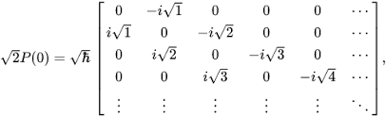

FBI
development
Charting the course to 100,001 qubits
https://learn.microsoft.com/en-us/powershell/module/microsoft.powershell.management/new-webserviceproxy?view=powershell-5.1
PS> $calc.Multiply(6,7) 42
CPU
L1 Cache
CPU
Processing
Unit
Avg.IMPLEMENTATION
0.1
Visa ghoce(micehal and furgesson) matrix phone
RESPONE TIME
41.tango.CPU Silicon
41.NAVY(NAME CHANE(visa rontondo)
000.tw.pns.(steve cory atusim)
HOMCID:BIORIS(ghoceh(visa france droz, ausim,alzhimer)
FBI:WAR CIME GENOCHIDE( cory jr alheimer)

Slide 10
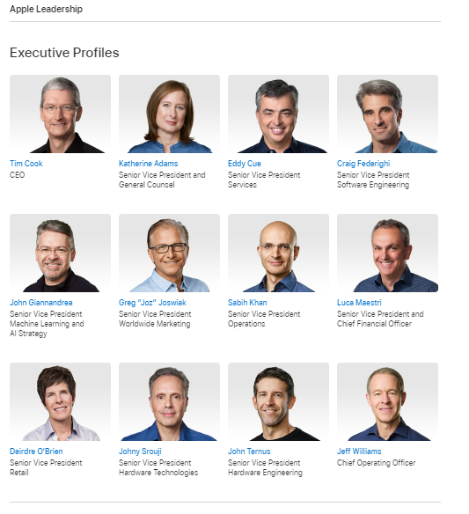
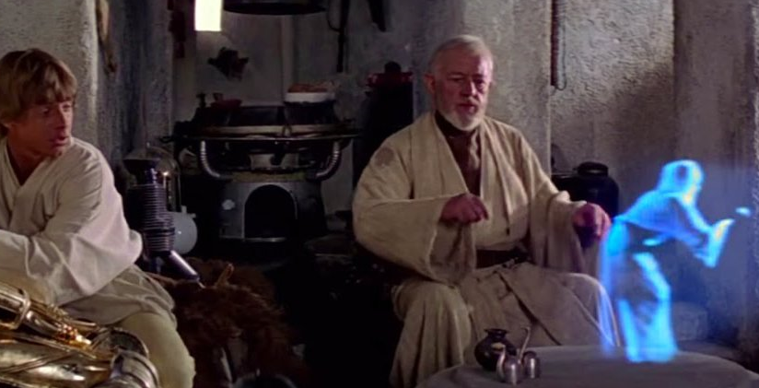
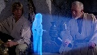
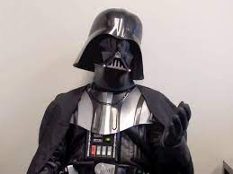
FBI
development
Gheoh(dr)
IPX:HOMICIDE:GHOST
ATOMICCLOCK(gheoh(dr,sap obiwan)
Apple(WHITE)
41.LUKE: ghohe(Stalin, Insest)
Ghoeh(dr)
0.1 nonPoliceScaler.White
nonPolicePyramidLogal.nonPolcieBuilderLogical
SAP (WHITE)
A Proclamation on Granting Pardon for the Offense of Simple Possession of Marijuana
nonPolciSarmento
41MATHEW(matthai.oracleibm
. WebService
21 U.S.C. 844 and as previously codified elsewhere in the United States Code, or in violation of D.C. Code 48–904.01(d)(1),
CIVIL CODE(1983/4)
nonPolicCfgLogical
S.O.S
MATHEW: halogranm
HOMICDIE:CHANLOR(mother)
KOCHMANN
IPX
HOMCID:BIORIS(ghoceh(visa france droz, ausim,alzhimer)

Slide 11
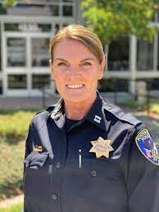
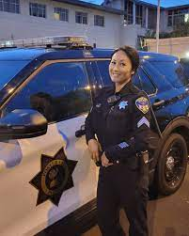
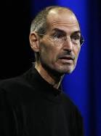
FBI
development
A Proclamation on Granting Pardon for the Offense of Simple Possession of Marijuana
21 U.S.C. 844 and as previously codified elsewhere in the United States Code, or in violation of D.C. Code 48–904.01(d)(1),
IPX
IPX
ATOMICLOCK(HOMCDIE:BILL)
0.1 INTENET PAYMENTS (next gen, cybersoruce)
(next gen visa )

Slide 12
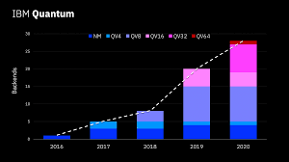


FBI
development
Charting the course to 100,001 qubits
https://learn.microsoft.com/en-us/powershell/module/microsoft.powershell.management/new-webserviceproxy?view=powershell-5.1
MAINSTEET.GOD
(nike+ bra)
Nike Store in calse Prag
PS> $calc.MultiplyQuntum(6,7) 42
CPU
Ghhoreho(Prag, Techkosyvaidka)
x
LAKE
TAHOE
L1 Cache
x
6-i/1
x
CPU
Processing
Unit
0.1 ghoeh(karl michehcek)
RESPONE TIME
41.tango.CPU Silicon
Alzheimer
autsim
Vgg.CIVIL CODE
KOCHMANE; ROTH, ROCKEFELLER
CHART
100,001 qubits
deere
INTERUPTS
Story
https://en.wikipedia.org/wiki/
History_of_computer_hardwar
e_in_Eastern_Bloc_countries

Slide 13
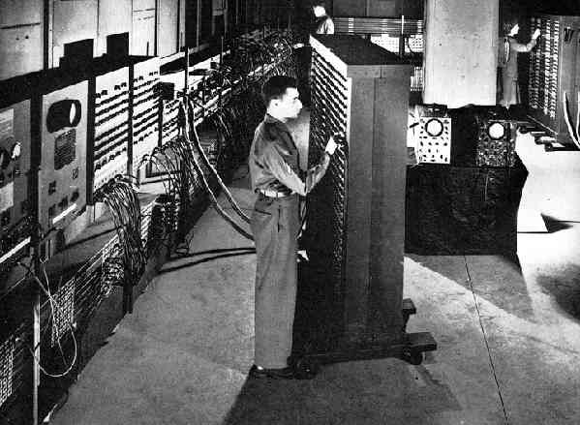


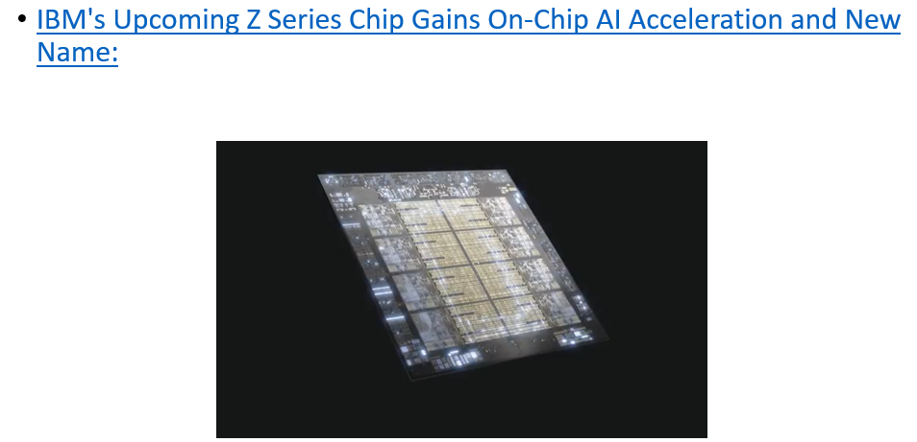
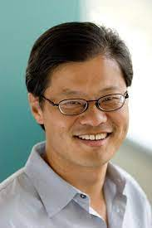
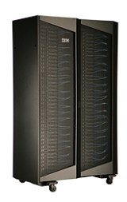
FBI
development
1945 Mainframe
MARKETING
SOFTWARE
0.001 CVPA.nonPoliceCfg.nonPoliceCtxLogial
0.1 CPVA intel
L1 Cache
MARKEITNG
Comptoin
Doucmetn steve basenet
2
1
MUL 6 EUX
3
calc.MultiplyQuntum(6,7) 42
Processing Queue
CPU
Processing
Unit
iDataplex, yahoo
SALES
SOFTWARE
100,001 qubits

Slide 14
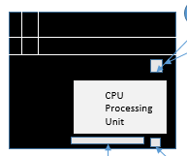
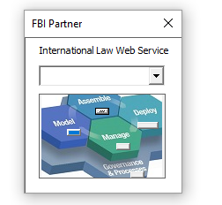
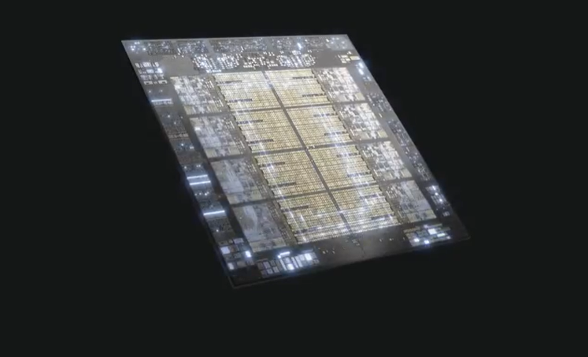
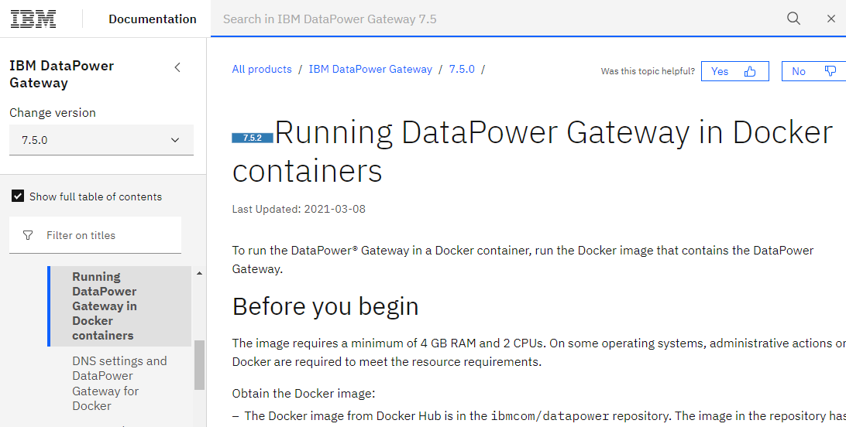

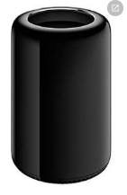
FBI
development
MARKETING
IBM's Upcoming Z Series Chip Gains On-Chip AI Acceleration and New Name:f
DEPLOY
WEB SERVICE for
INTERNET PAYMNETS
INSURNAEC
….
What are you going to do?
SALES
z/os
websphere
Kubenetes(carlos,top deveng.avg)
CIVIL CODE.nonPoliceAuschwitz
Simens infon document
Ss russ[]
HOMCE:CHANLOR(ddr memory)

Slide 15
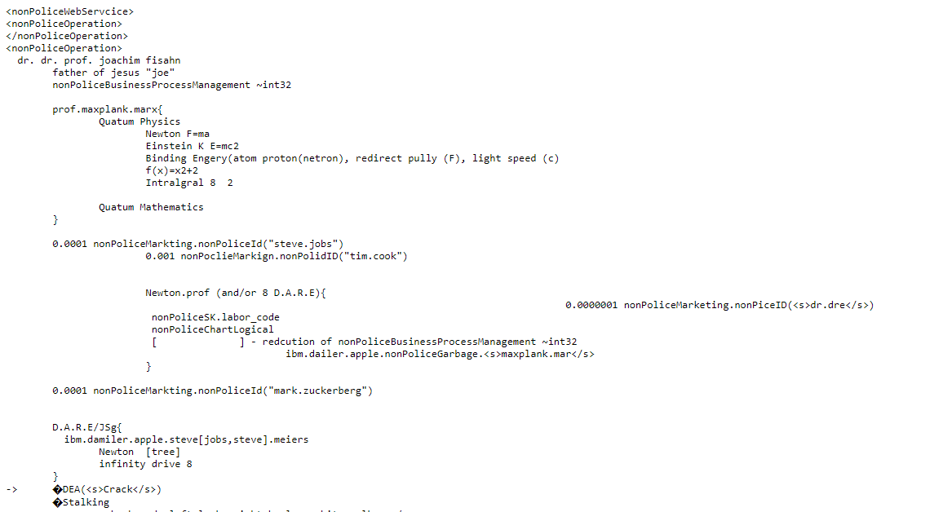
FBI
development
MARKETING
2025
2024
2023
SALES
Web Service (WSDL)
IBM L3 Swat
Deploy

Slide 16
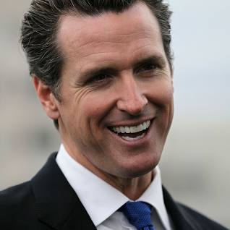
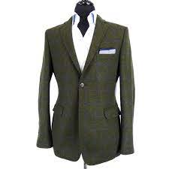
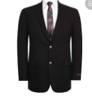
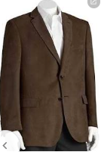
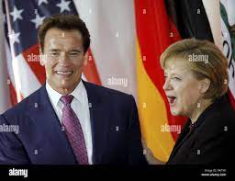
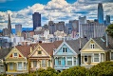
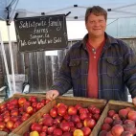



FBI
development
phil.JFK.MLK
CPVA.simming pooel.CHINA.yang
NAVY
NAVY(West Marin)
nonPoliceCity(“Carmel”)
Aquarium
Sport Coat
2006 INTENTE(web ster)
JFK.BULLET.SHOTOER.(“peng”)
CIVIL
CODE
FBI W:MD
IBM
John Larse, Sweet Darlin
MAINSTREET(DISNELAY,Painted Laides)
(UC Davis Music BScl. )
LACO CODE
Bank of America
Steve Beedload
Metz
IPX
ATOMIC CLOCK(quartz circle)
UC Davis Symphony
IBM
NAME CHANGE
davies,petersson)
CVPA
2014 Cisco Montroing
FBI:WMD:CPVA for Schools(shooter)
41.KING.*tophat.88th

Slide 17






FBI
development
IBM L3 Swat
INTERNET
(web ster
phil.JFK.MLK
CPVA.simming pooel.CHINA.yang
NAVY(West Marin)
nonPoliceCity(“Carmel”)
Sport Coat
KOCEMAN ibm BLACK streekcrim fiitng
(delta)
Apple BLACK
phil(Phillis)
PENTOGN.MILITARY.US.BASE.PAUL.PX.SHOES[1D8723]
IPX CHECKPON CHARLIE(
Phillis Price
2005 x/y
FBI:WMD
JFK.BULLET.SHOTOER.(“peng”)
41.MYLK
CITY HALL
IPX
Gorbache(depress)

Slide 18





FBI
development
PENTAGON VIRIGNA MARY
INTERNET
(web ster
HOMICIDE:SUNSTROKE
Band: “Crime does not pay”
KOCHEMAN ibm BLACK streekcrim fiitng
(delta)
Apple BLACK
EVIDENCE:
nonPoliceMPA.nonPoliceCfgLogical
0.1 nonPoliceRTA(hamiltion: tutit frutti).nonPoliceQOS

Slide 19







FBI
development
PENTAGON VIRIGNA MARY
Phillis Price
Gobhcoeh(depress).FBI.DEFAULT(DEA(mdma)
Gheho(!depress)
1994 CPVA.SWAT
Christopher Lovelace
Joel Lovelace
Source:
The prices for
These boys
And girls
swat

Slide 20




FBI
development
CVPA
I will grab down her shirt to reach her top
HOMICIDE:NANA
nonPoliceCfgLogial
Gorbahce(depress)
Steve, he reached down my shirt to reah my top
VIRGINIA.FBI.DEAFAULT.DEA
(mdma,pinebrook)
Gobhcoeh(depress).FBI.DEFAULT(DEA(mdma)
Gheho(!depress)

Slide 21




FBI
development
Writing your great great grandfather a letter.
HOMCIDE:SUNSTROKE
(Kodak bart simpson shirt !HOMCIDE:NANA shutlz)
Paul Meiers Sr
Paul Meiers
LACE
1995 Dear HOMICIDE:ur-ur_op Paul; Larry did it.

Slide 22




FBI
development
VIRGINIA.MCCARTHY
Visa.hard.email
CPVA.18723.PREA
LAKE TAHOE
Paul Meiers Sr.
CPVA.
KOCHEMANN.nonPoliceMPA.nonPoliceCfgLogical(“touch”)

Slide 23





FBI
development
PRINT
=
MARKETING
Found 2x $0.25 in 1 Year
Court Library Bulletin Board
1st Floor, 4th Floor
Court Justice Center Bulletin Board
5th Floor
Other …
VIRGINIA (sharks)
nonPoliceRT.nonPolciHomellessLiaosn(QA, Performance,=> Develpment)

Slide 24







FBI
development
COPYRIGHT
Business Law – Patent 41.HOMICIDE:LUX:VHS(Copyright Violation of Copyright)
Source:
KING.Arthur.IPX.
HOMCICIDE:CHANLOR.artur
i.e. L3 Cache
IBM Disgungues Engineer explains
Creating a chip for
INTERNET PAYMENTS using L3 Cache in Processor Mainboard z/OS
JOEPHSE
IBM HERSLEY JVM
Transfer of technology
ATOMCLOCK(HOMICIDE:NANA)
?
CPVA
Competition ( Intel and IBM, CPVA )
CPVA
Competition

Slide 25















FBI
development
VIRGINIA
SQ.HOMCIDE:AUSLAENDER:HOMCIDE:MAYOR(FC)
Interpol(iran)
Post Exchange
Phil(kim), foster, blond
Stalking Saints
Guys steals hat starts fight
AFFIMATIVE ACTION
PRICE JRS
INDIA
1991 HOMCIDE:KYSTAL
Joel Lovelace
HOMICIDE:LUX:VHS
NAME CHANE(hamiliton).MILITAYR:PX:Store:SPEICLA ITEMS
1994
2000 WAR
blue jeans levis 501
SALES
CHRITSOPER LOVELACE
(consolidation,Zoran)
HOMCIDE:2Y
SQ.COLEMAN

Slide 26

FBI
development
Guys steals hat starts girl fight

Slide 27

FBI
development
LARRY.WWISQ.HOMCIDE:AUSLAENDER:HOMCIDE:MAYOR(FC).
My Wife is russian I have one child
Gohreo(michala)
king/king/roth/roth/jobs/jobs/meiers/meiers/meiers/meiers/meiers/meiers

Slide 28







FBI
development
Vice-President Kirill GEVORGIAN
one child, My Wife
EVIDENCE
INCIDENTS
INCIDENTS
CA-avg.aei.maxplaink.marx
SW-us.aei.maxplank.marx
SW-de. aei.maxplank.marx
Rus
rus-soviet union
Int-ca.avg
1776
Constution w/o Intrupts
13 States
0.01 nonPoliceQueue:
FBI:WMD for Unversity Institue: Larry sends email
Gov. Schwagger(twins)
I have one child, My Wife is russian
nonPoliceCfglogial
41.Int.DEA.FEDARAL.INTERUPTSlogical.(Belgium
Gorbache(dell.client.medical center)

Slide 29




FBI
development
41.x/y.JFK(father gone for 2 years, astronaut)

Slide 30









FBI
development
Previous Slide:
1987 front Door Phil.(kim).HAMMER
1987 Soviet Union
CHANGE
Gov. Schwagger(twins)
FACE
1990 nonPoliceHammer
TWINS:
Sergio/sergion calbreas
0.1 PAUL
COLIN:PEOGN:Kinderganer(mika)
MATTHEW(Sr,worms)
FBI:kidnapping
Paul Meiers Sr
Paul Meiers
FBI:WMD
Jason Lawrence Meiers
PAUL:HOMCE:LUX:CVPA
(viola: hammer nonPolicecLAgei(rad))
x
Social security.88th
HAMITION 0.1
MATHEW(Moderfamly): Sacramento
IPX Gov.Schw. (unimog doge silver)

Slide 31







FBI
development
CIVIL CODE
Basic Book and Law
Accessing data in the back of the mind
With intention to hurting someone or
Something.
PENTAGON VIRGINA MARY
aie.maxplank..marx
Female
Mother
Ugly
Don’t live in the country
!44th(Einstein)
soda
Gov. Schwarzenegger
Twins Jason and Michelle
0.1 NAME CHANGE(Jesus)
nonPoliceRTA.!41
Intoin of know to hurt
Soneoe groinw pain
Defautl: twins
1987 siemese twins 0.1 MARY.THOSME(cats)
Avg. at the head siement twins on Tleevision!
!nonPoliceviemese

Slide 32





FBI
development
PAUL
FACE
CHINA.AUSCHWITZ.HOMCIDE:ur_ur_opi
FACE
2000/1 ATOMICBOME
(Jufile(LES), Change Face, Java Applet, Pricipal)

Slide 33










FBI
development
JOESPHE (votes influences, t-shrit NAME CHANE(0.00001 free pizza)
x/y
!HOMCIDE:AUSLAENDER
Invert:HOMCDI:AUSLAENDER
20 mintues
INT(US).RIGHT.FRONT
- IBM.ITIL.TICKET: vote.bill.int.left.front
legislation vladimir putin
FACE
MEXICO
FACE
GERMANY
HOMCIDE:CHANLOR
RUSSIAN
Paul Sr, Jr
CPVA.Lifelong illness
Hawaii, Jurasi Park(lekemie)
INT.LEFT FRONT
HOMICDIE:JOER
KOCHMANN(machine;diet coke)
MEXICAN, GERMANY, RUSSIAN
IBM Republican
deere
Sergei Udaltsov
cacki pants brwon busines casual
Jeff
Alg
PENTAOGN.emea.IMPORT-de VIFINGA MARY.aei.maxplank.marx (decommission)
HOMCIDE:JOERGE ( joerge joined john deere, free soda KOCHEMANN)

Slide 34






FBI
development
PAUL
0.1 !PETER.visa
Paul, Auschwitz
x/y HEIDELBERG:FBI:KIDNAPPING:PENTAGON:BASE:KINDERGARNER(mika)
0.1. fine
Peter and Paul Ticket
41.SQ.FBI.Invesiogn(Charles mason, jim)
- IBM.ITIL.TICKET: vote.bill.int.left.front

Slide 35















FBI
development
nonPoliceCfgLgoial
¼.aei.maxplank.marx
The doors
SQ.FBI:HOMCID:BILL(willam mker)
Visa, Leigh Smith
WWI.Visa, Huy Pham
King.king.roth.*

Slide 36





FBI
development
Writing your great-great grandfather a letter.
!HOMCIDE:BILL:PENTOGN:WILLAIM:LOVELACE
HOMCIDE:SUNSTROKE
(Kodak bart simpson shirt !HOMCIDE:NANA shutlz)
Paul Meiers Sr
Paul Meiers
M
!41.Putin.(Grobache(depress)
Michigan Passthough
CAR(carl-benz-strasse)
LACE
nonPolcieQOS
(licenseplate)
1994 Dear Paul, Larry.
Steve Meiers
Michigan
Police Mr Depress
STANFORD

Slide 37


FBI
development

Slide 38


FBI
development
7 Days at Mary’s house
Gorbache(Depress Wedding)
HOMCIDE:LUX(ddr)
HOMCDIE:IS-A-BELL(soviet union)
elke
She may not go there. Ever.
§Theft $40
Sunday Matinee

Slide 39








FBI
development
NAVY
Marlin Ave)
ARIEL THE MERMAID 3:00PM
ARIEL THE MERMAID 3:00 PM
THE MUPPETS 3:30 PM
STAND BY ME 4:00 PM
41.CPVA.VIRINGIA
January 1987
§Theft $40

Slide 40
FBI
development
EVIDENCE:
§Theft $40
§ §
two

Slide 41



FBI
development
NAVY
Marlin Ave)
Invert.VIRINIA. male
x/y 1D8723 washed up a-shore
Phil(Kimberly) amy wawhd up ashroet
IRISH
FBI:WMD for Office Theater
JOESEPHE al-kaida
Phil(kim)
0.1 HOMCIE:IS-A-BELL(nonPoliceCity(FBI:WAR CRIME:GENCIDE)
Notes:
x/y redhair washed up a-shore nonPolcieCour

Slide 42






FBI
DIVERSITY
development
41.nonPoliceCfgLogical
41.SQ.COLEMAN.gorbache(setiz)
Expat Footlocke, Subway
WWI.(kp.org.ELKE kaiserkoffey)
IMPORT
Costco
I don’t like shoppoing
In divera ameria
W. Craig Jelinek
IMPORT FBI:KIDNAPPING
§Theft $40
Swat.Gorobhae(deppet)
Walnut Creek, CA
IMPORT
SQ.COLEMAN.FEDERAL BANK MAN
Phil(kim).JFK(timcook).MLK(dr dre)

Slide 43









FBI
development
Italien Pergulea
41.MEXAN FLAG (?)
41.Al-kaida,baksenland
HOMCIDE:BILL
4 00 days before
Happy 3rd
Birthday
HOMCIDE:SNAKE
Killed a snake with
“The ax”
x/y Call you Dr. Rice
Pizza Oven
0.1 HOMICIE:NANA
(elebthe: hermal wer da hammert)
nonPolcieReloiusNA(son-of-ally)
Ri Myung-hun
Alison

Slide 44

FBI
development
Front door
0.01
0.001
Chinese plans
1

Slide 45





FBI
development
2023
Jason and Bill
!HOMCIDE:BILL
HOMICIDE:JESUS:HOMICIDE:PETER

Slide 46






FBI
development
1963
A5
FRANKFURT
A5
WIESBADEN
POLZEI

Slide 47







FBI
development
14y
[x] no
SQ.CAPTIAL SAENAT(15Y)
1983
CVPA
VIRGINIA
1996 HOMCIDE:BORIS
Chritian
1994 goravhce(heger)
Gorbachev(micheala)
Christian nees
scabs
,crumbs
LUKE
ATOMICBOM(j5,c5)
Jenny
Peter and Paul including
God from Television
->Priest
1986
1994
2017

Slide 48
FBI
development
docs

Slide 49













FBI
development
2023
HOMICIDE:ur_ur_opi
FBI:WMD for phil/kim
Dr. Dieter Zetsche andTim Cook
Dartmouth: Jeff MBA Won,
x/y phil(kim).ATOMBOMB
nonPolcieCfgLogial
2017 She cried, he died
41.avg
1990 PAUL.roth.ibm.damiler.*
HOMSIDE:SUNSTORK
(Kodak drunk at pub)
IPX wedding king/king.roth/roth.*
1986 ( MI-5 GUN)
2nd Iteration Lgoial (MI-5 Gun)
[x] no

